Slide 1
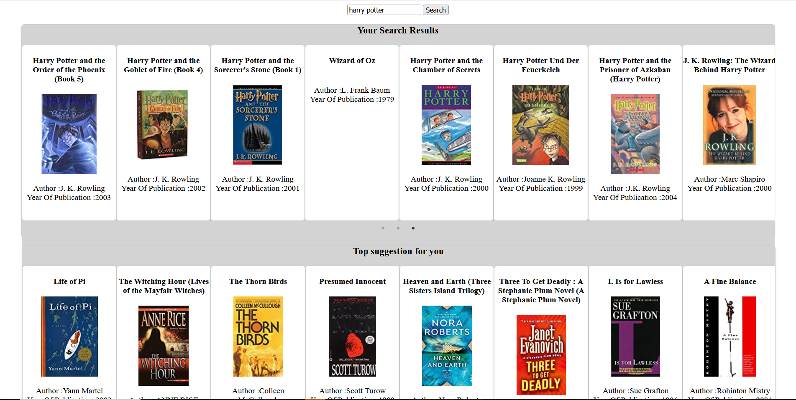
Search Page
Similar Book Search
KNN based text search on book names
Ball Tree optimization
Uses Euclidian distance
Book names are converted to numeric vectors using sentence transformer
Suggestions based on user history
This has been implemented using user-user CF
Funk SVD matrix factorization approach
Uses saved pkl model file for prediction

Slide 2

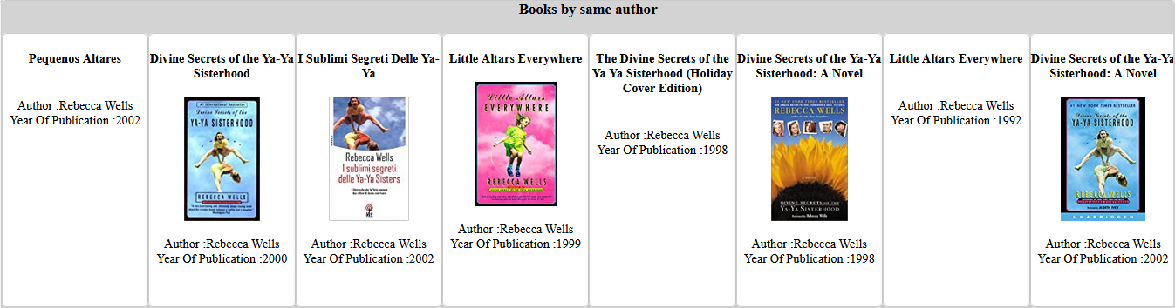
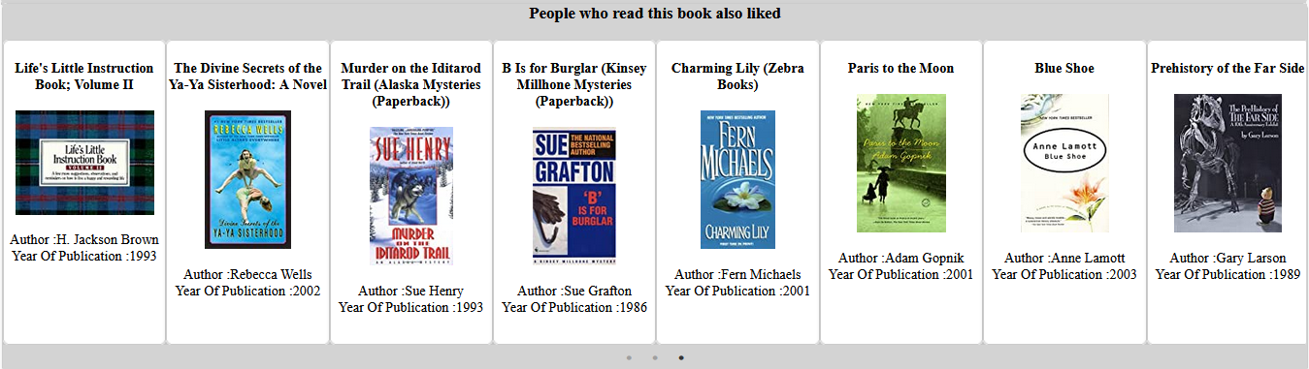
Book Info Page
Read This Read That
Implemented using association rule mining
Confidence=0.6, support = 0.05
Books by same author
Implemented using SQL Lite
Simple data Query
Items having similar user ratings
Item-Item CF
Implemented using SQL Lite
Cosine Distance has been used to calculate similarity between items

